Slide 1
Compressors
Basic Classification and design overview

Slide 2
What are compressors/pumps?
Compressors/pumps are mechanical devices that compresses gases/liquids. It is widely used in industries and has various applications

Slide 3
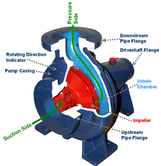
How compressors are different from pumps?
Major difference is that compressors handles the gases and pumps handles the liquids.
As gases are compressible, the compressor also reduces the volume of gas.
Liquids are relatively incompressible; while some can be compressed
Centrifugal pump

Slide 4
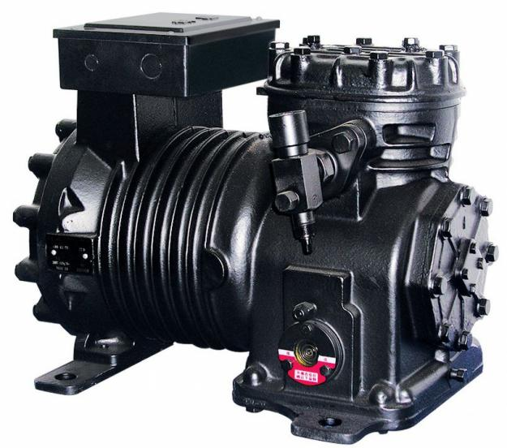
What are its applications?
Compressors have many everyday uses, such as in :
Air conditioners, (car, home)
Home and industrial refrigeration
Hydraulic compressors for industrial machines
Air compressors for industrial manufacturing
Refrigeration compressor

Slide 5
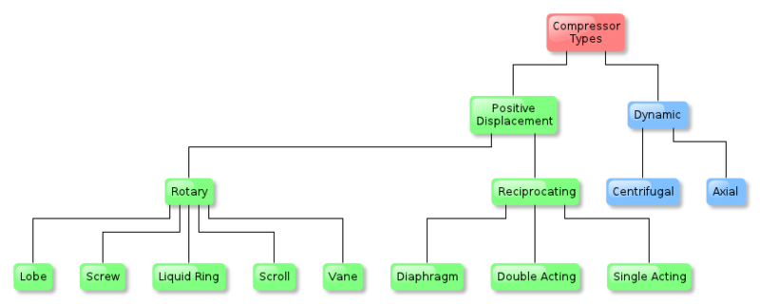
What are its various types?
Compressor classification can be described by following flow chart:

Slide 6
What are dynamic compressors?
The dynamic compressor is continuous flow compressor is characterized by rotating impeller to add velocity and thus pressure to fluid.
It is widely used in chemical and petroleum refinery industry for specific services.
There are two types of dynamic compressors
Centrifugal Compressor
Axial Flow Compressor

Slide 7
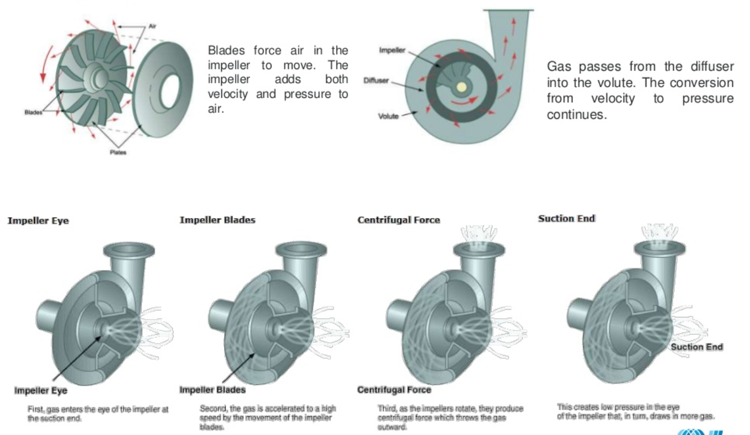
Centrifugal compressor

Slide 8
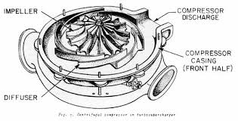
Centrifugal Compressor
Achieves compression by applying inertial forces to the gas by means of rotating impellers.
It is multiple stage ; each stage consists of an impeller as the rotating element and the stationary element, i.e. diffuser
Fluid flow enters the impeller axially and discharged radially
The gas next flows through a circular chamber (diffuser), where it loses velocity and increases pressure.

Slide 9
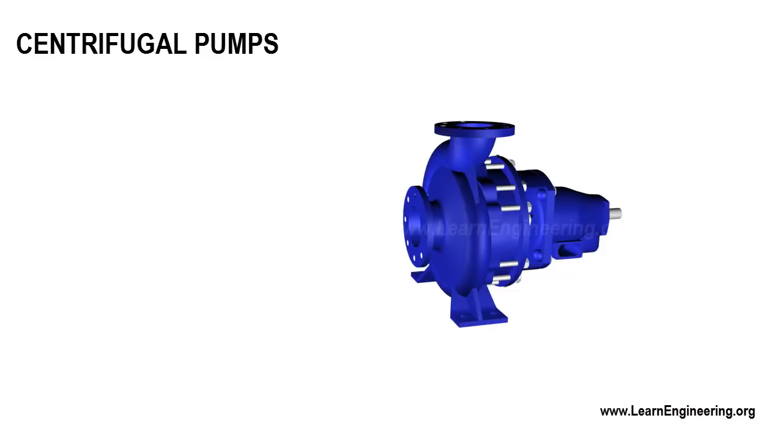

Slide 10
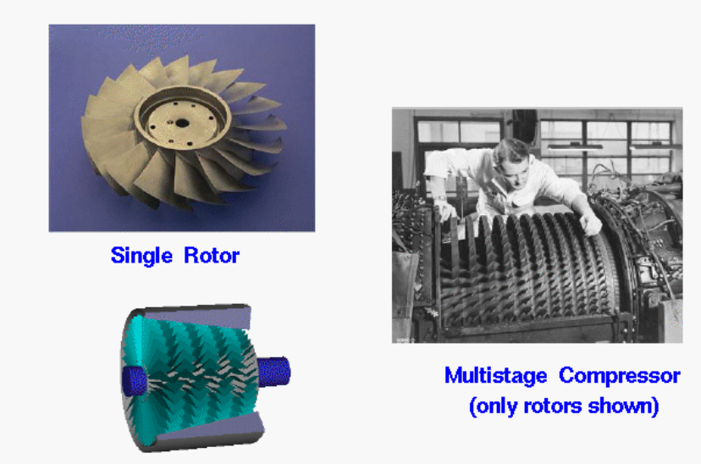
Axial flow compressor

Slide 11
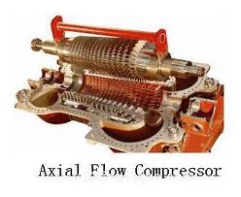
Axial flow compressor
Working fluid principally flows parallel to the axis of rotation.
The energy level of air or gas flowing through it is increased by the action of the rotor blades which exert a torque on the fluid
Have the benefits of high efficiency and large mass flow rate
Require several rows of airfoils to achieve large pressure rises making them complex and expensive

Slide 12
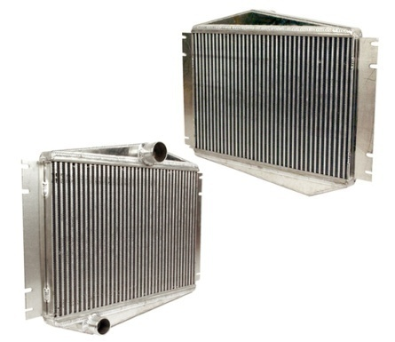
Why multistage compressor?
High temp rise leads into limitation for the maximum achievable pressure rise.
Discharge temperature shall not exceed 150ºC and should not exceed 135⁰C for hydrogen rich services
A multistage centrifugal compressor compresses air to the required pressure in multiple stages.
Intercoolers are used in between each stage to removes heat and decrease the temperature of gas so that gas could be compressed to higher pressure without much rise in temperature
Intercooler

Slide 13
What are positive displacement compressors?
Positive displacement compressors causes movement by trapping a fixed amount of air then forcing (displacing) that trapped volume into the discharge pipe.
It can be further classified according to the mechanism used to move air.
Rotary Compressor
Reciprocating compressor

Slide 14
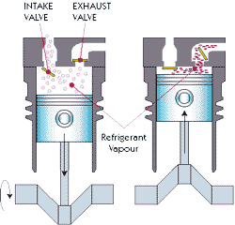
Reciprocating compressor
It is a positive-displacement compressor that
Uses pistons driven by a crankshaft to deliver gases at high pressure.
The intake gas enters the suction manifold, then flows into the compression cylinder
It gets compressed by a piston driven in a reciprocating motion via a crankshaft,
Discharged at higher pressure

Slide 15
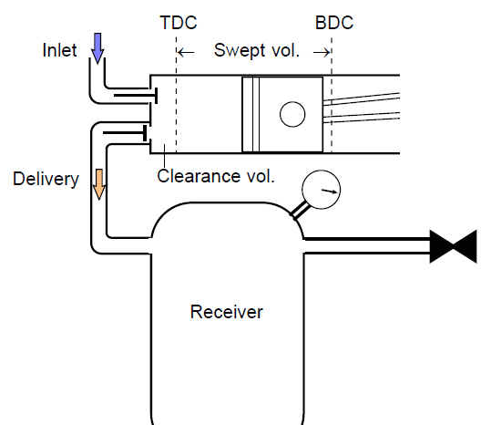
Block diagram of reciprocating compressor
It is a piston and cylinder device with (automatic) spring controlled inlet and exhaust valves
There is a clearance between the piston crown and the top of the cylinder.

Slide 16
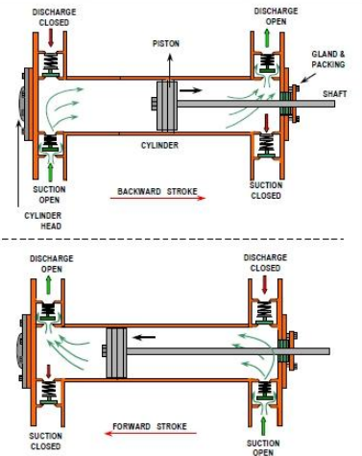
Double acting reciprocating pump

Slide 17
Advantages and Disadvantages of dynamic compressors
 | Advantages | Disadvantages
Dynamic Compressors
Centrifugal | Wide operating range High reliability Low Maintenance | Instability at reduced flow Lower efficiency than axial compressor
Axial | High Capacity for given size High efficiency Heavy duty Low maintenance | Low Compression ratios

Slide 18
Advantages and disadvantages of positive displacement type compressor
 | Advantages | Disadvantages
Positive displacement compressor
Reciprocating | Wide pressure ratios High efficiency | Heavy foundation required Flow pulsation High maintenance

Slide 19
Thank You

